Slide 1
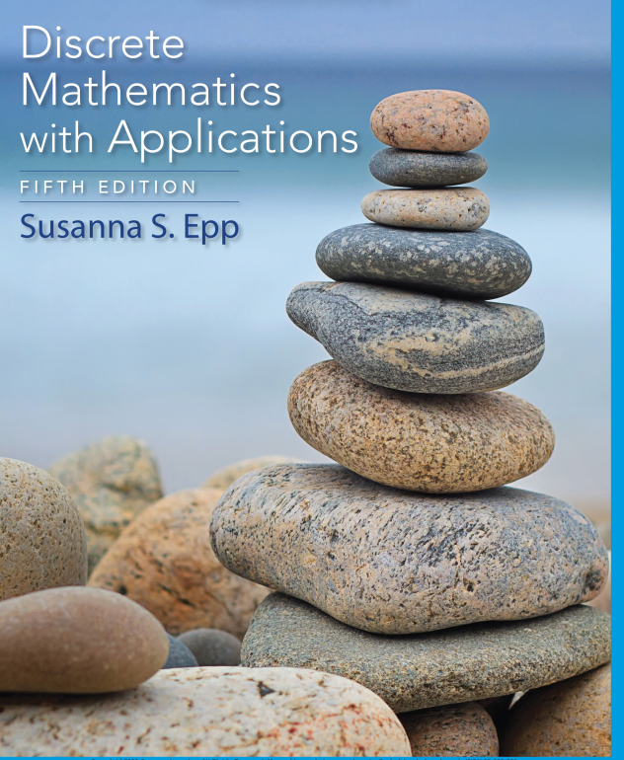
Chapter 1
Database Systems

Slide 2

Faculty of Computer Science
UFCFFS-30-1– Foundations of Computing: Analysis of Algorithms & Algorithm Complexity & Big-O notations
Instructor: Duc Minh Vu
2/25/2024
Data Structures and Algorithms in Python
2

Slide 3
Learning Objectives
Real-Valued Functions of a Real Variable and Their Graphs
Big-O, Big-Omega, and Big-Theta Notations
Analysis of Algorithm Efficiency I
Exponential and Logarithmic Functions: Graphs and Orders
Analysis of Algorithm Efficiency II

Slide 4
Reading
Chapter 11 - Discrete Mathematics with Applications 5th Edition (Susanna’s Book)
Chapter 3 – Discrete Mathematics and Its Applications 7th Edition (Kenneth Rosen’s book)

Slide 5
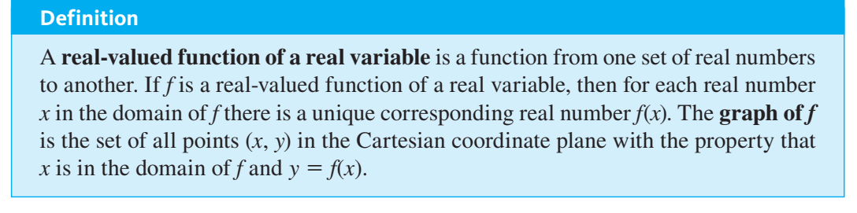
Real-Valued Functions of a Real Variable and Their Graphs

Slide 6
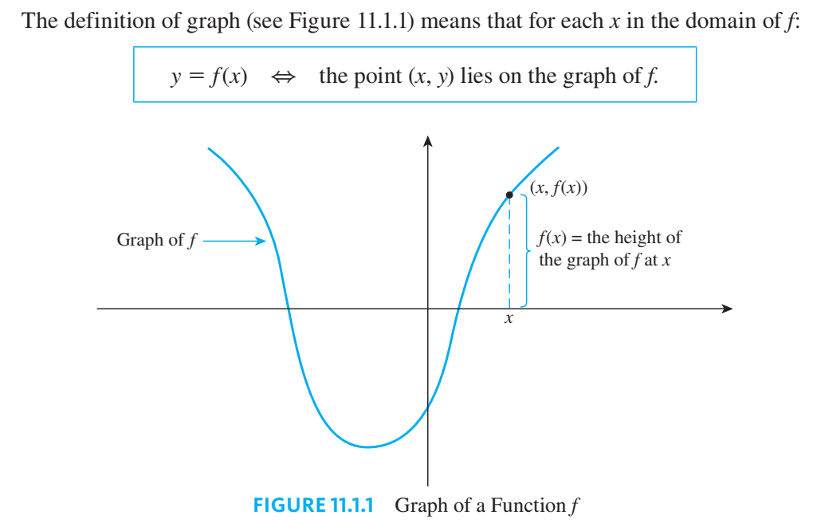

Slide 7
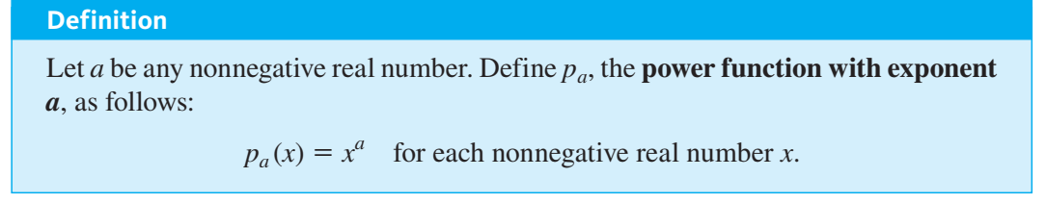
Power Functions

Slide 8
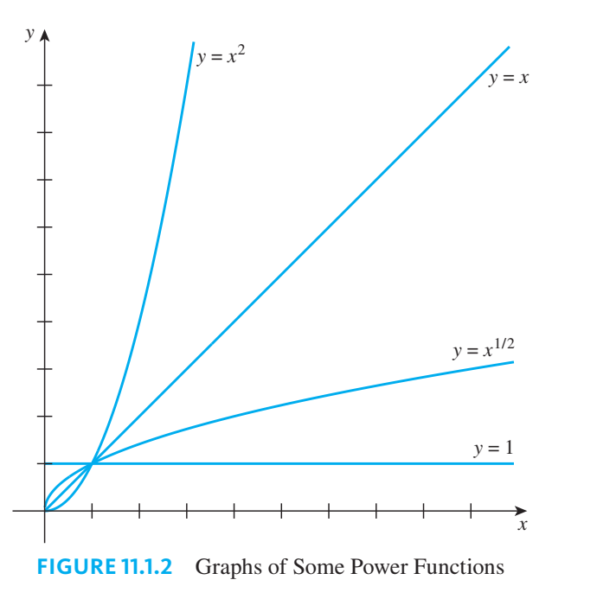
Graphs of Power Functions

Slide 9
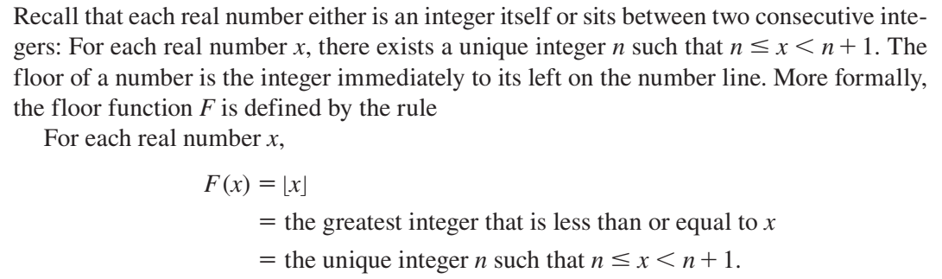
The Floor Function

Slide 10
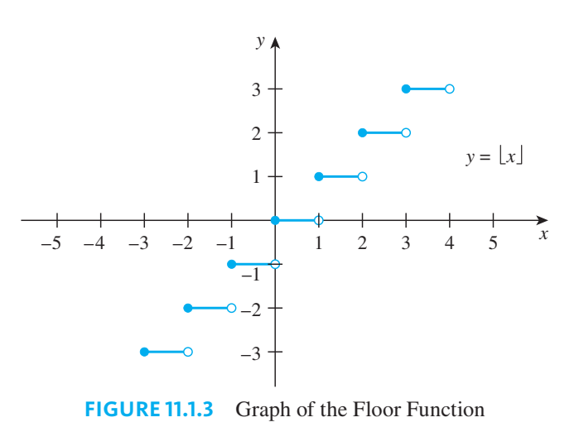
Graph of the Floor Function

Slide 11
Graphing Functions Defined on Sets of Integers
Many real-valued functions used in computer science are defined on sets of integers rather than on intervals of real numbers.
If you know what the graph of a function looks like when it is given by a formula on an interval of real numbers, you can obtain the graph of the function that is defined on the integers in the interval using the same formula by selecting only the points on the known graph whose first coordinates are integers.

Slide 12
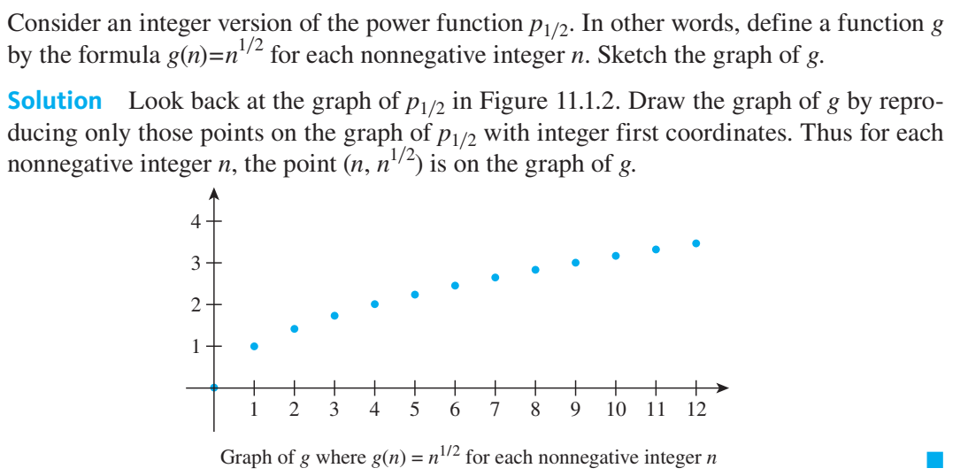
Graph of a Function Defined on a Set of Integers

Slide 13
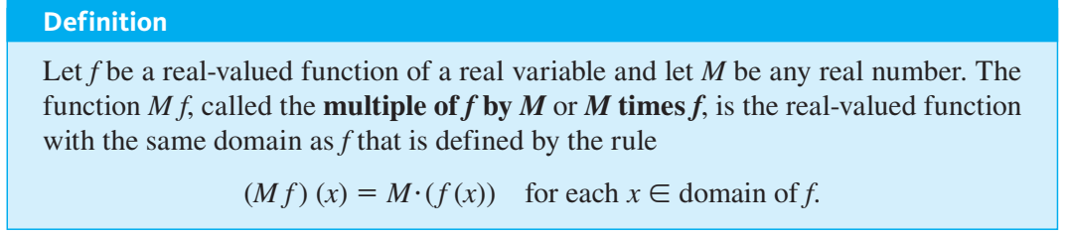
Graph of a Multiple of a Function

Slide 14
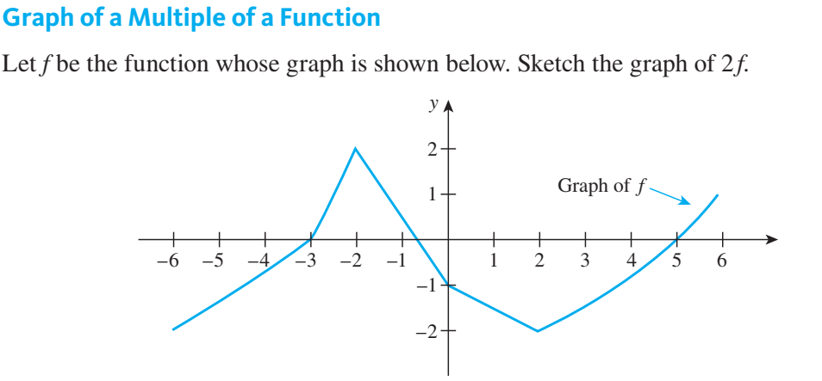

Slide 15
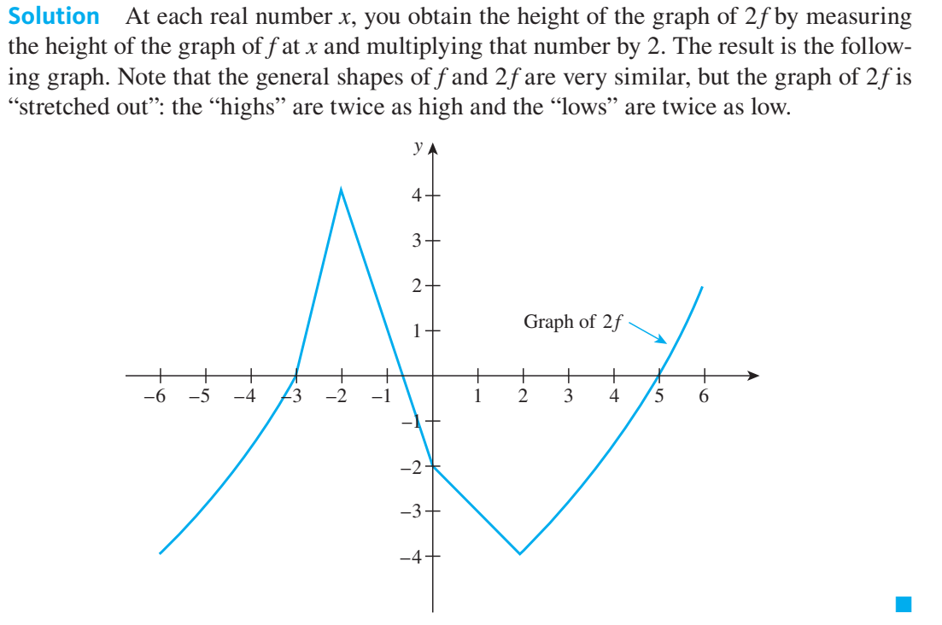

Slide 16
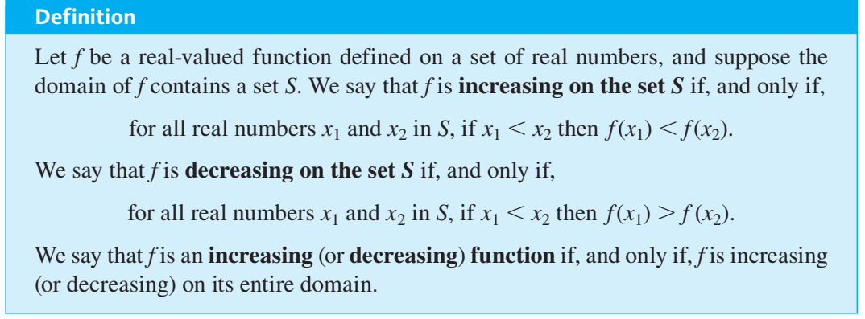
Increasing and Decreasing Functions

Slide 17
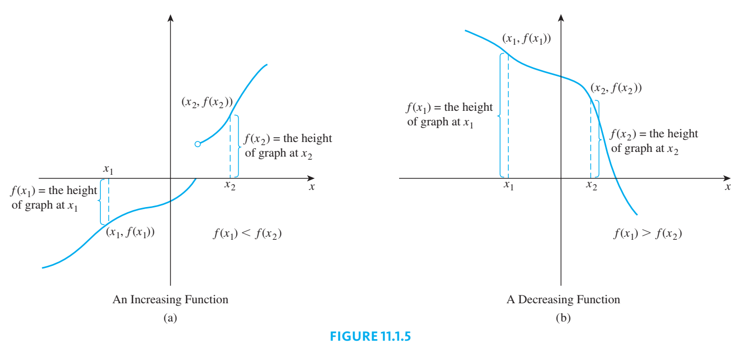

Slide 18
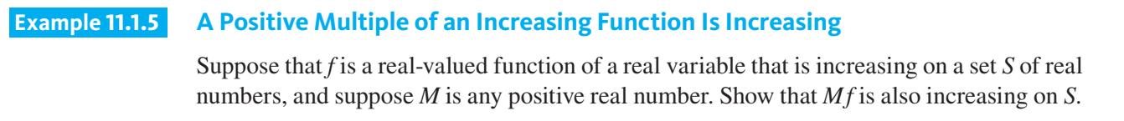

Slide 19
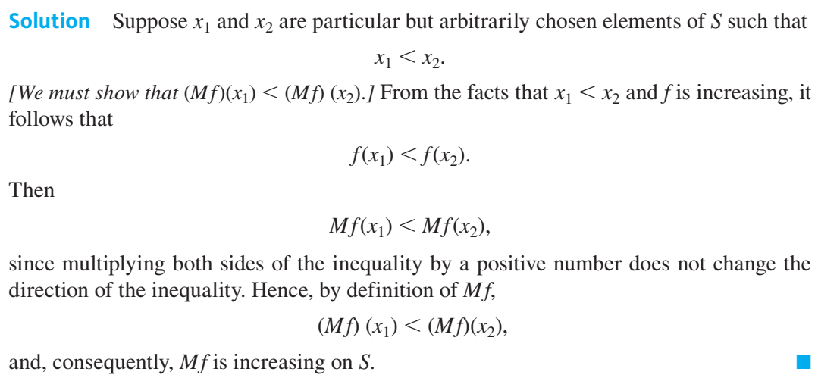

Slide 20
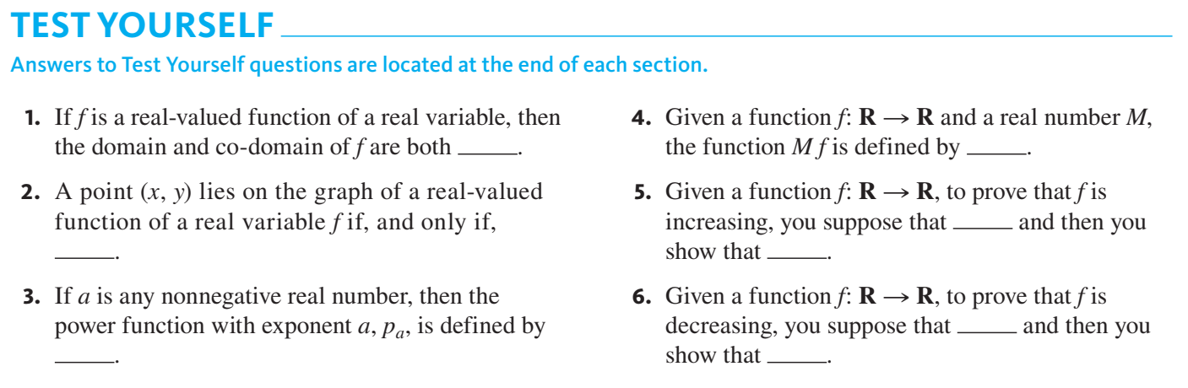

Slide 21
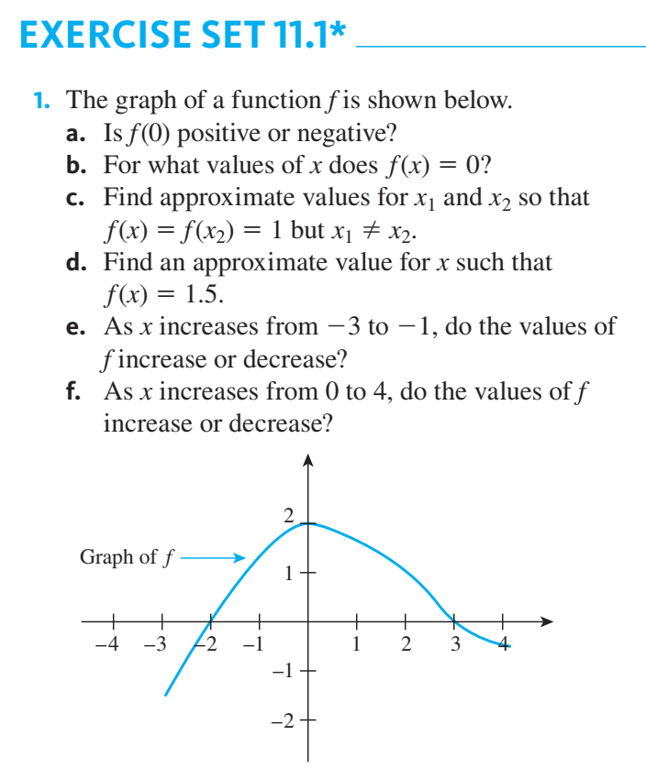
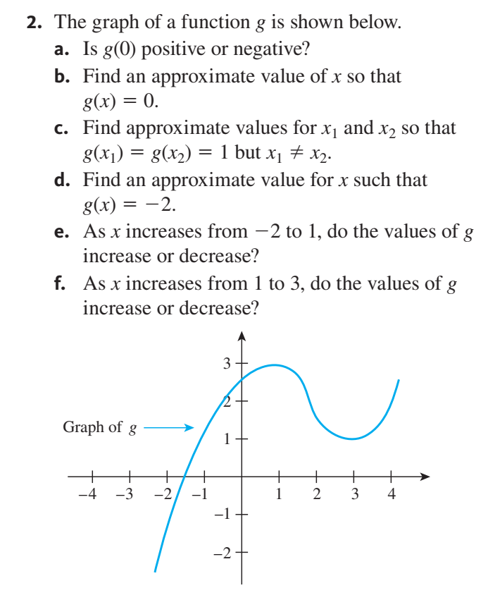

Slide 22
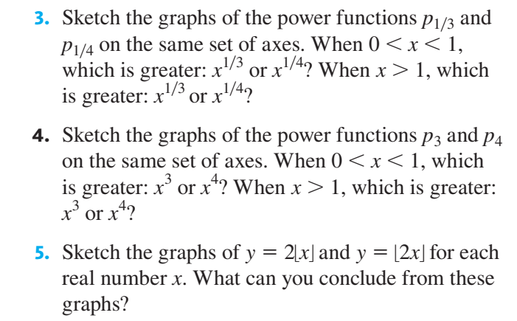

Slide 23
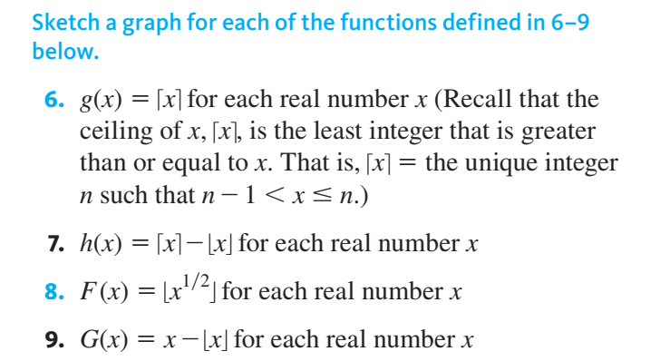

Slide 24
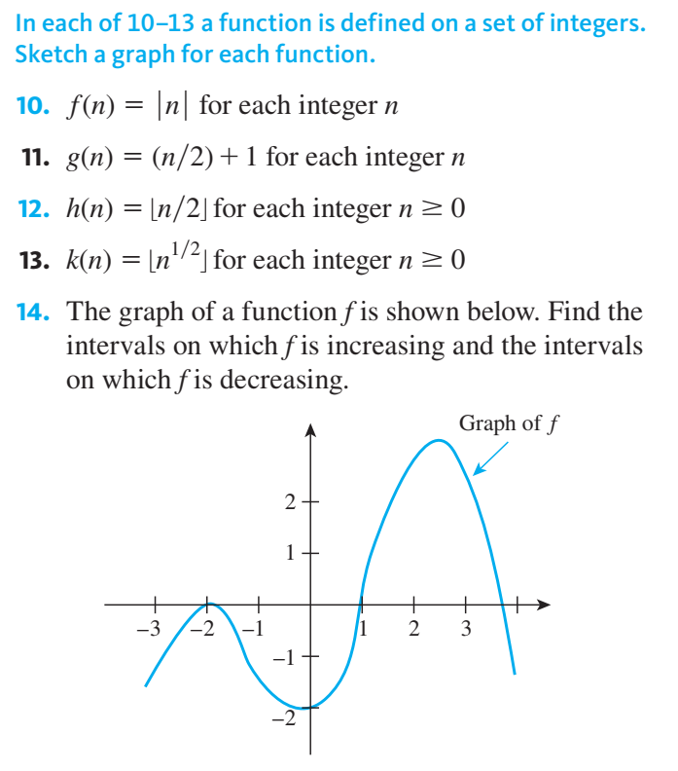

Slide 25
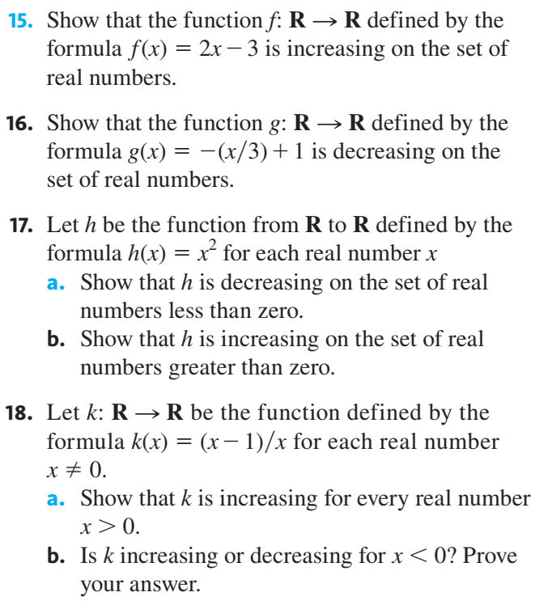

Slide 26
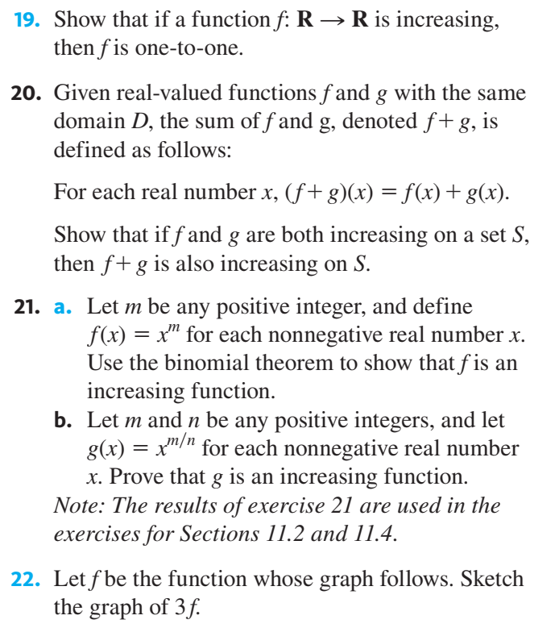

Slide 27
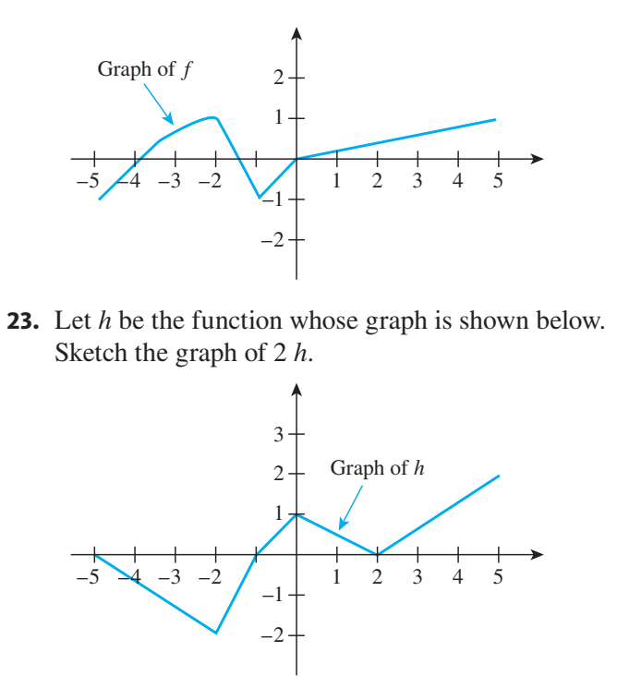

Slide 28
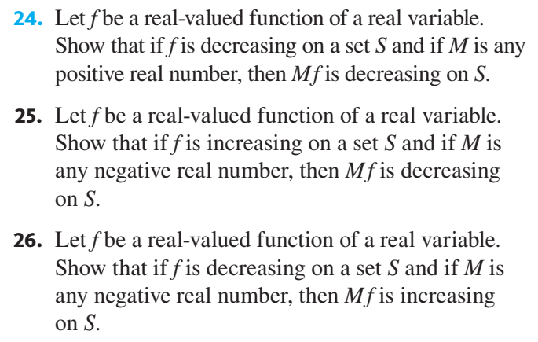

Slide 29
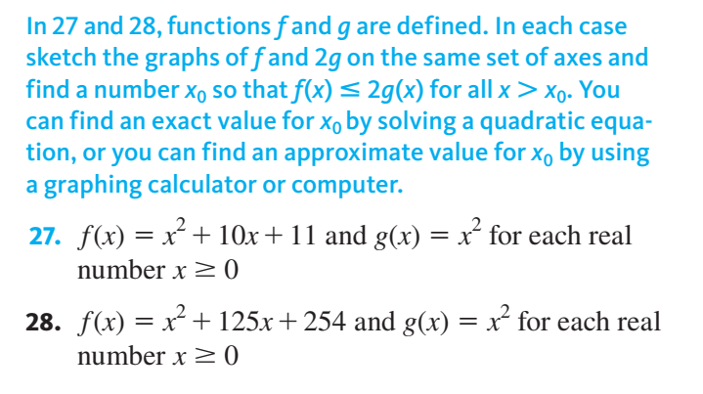

Slide 30
Big-O, Big-Omega, and Big-Theta Notations

Slide 31
Big-O, Big-Omega, and Big-Theta Notations
The cost and feasibility of implementing a computer algorithm are most affected by the length of computer time and the amount of computer memory the algorithm requires.
This chapter concentrates on basic techniques for calculating time efficiency, which is usually the more significant of the two.
Best and worst case for an algorithm: e.g. searching an element
Focus on the worst case

Slide 32
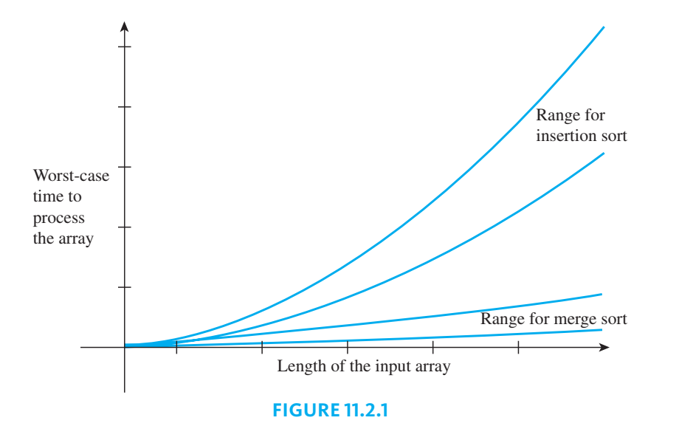
For example, sorting a data set with 10 million items could take just a fraction of a second with merge sort but approximately 30 minutes with insertion sort

Slide 33
Big-O, Big-Omega, and Big-Theta Notations
O-notation (read “big-O notation”), was introduced by the German mathematician Paul Bachmann in 1894 in a book on analytic number theory, and it was the first to be used to compare efficiencies of algorithms
In 1976 Donald Knuth, a pioneer in the analysis of algorithms, introduced the Ω and ϴ-notations so that the growth of functions could be compared with greater precision.

Slide 34
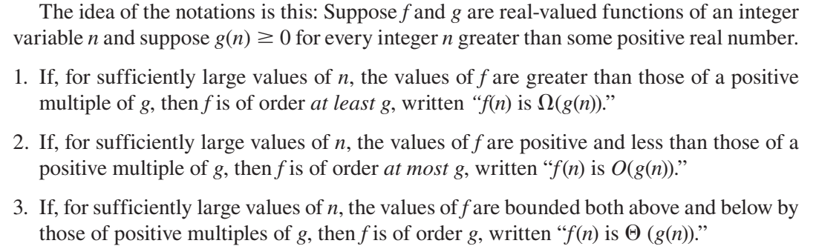

Slide 35
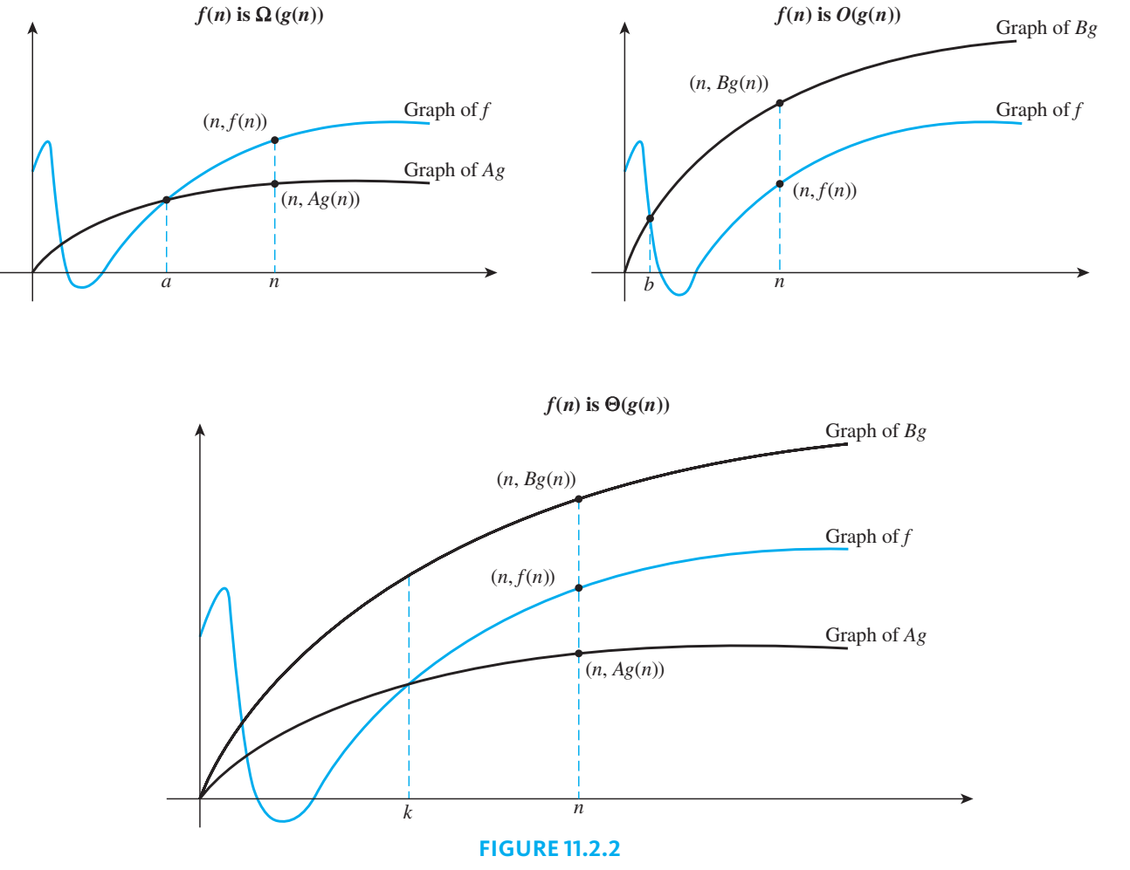

Slide 36
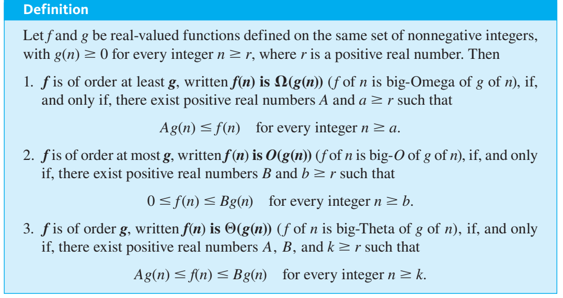

Slide 37
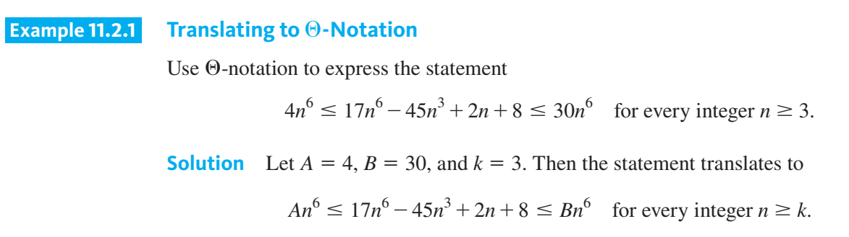

Slide 38
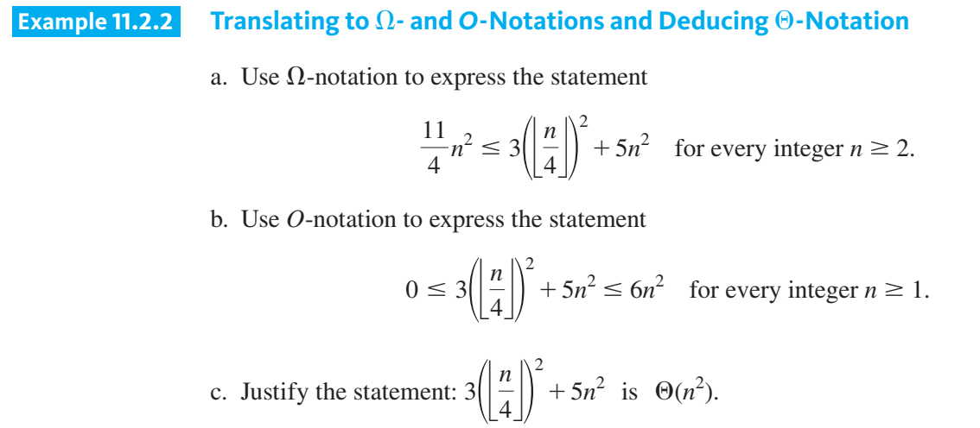

Slide 39
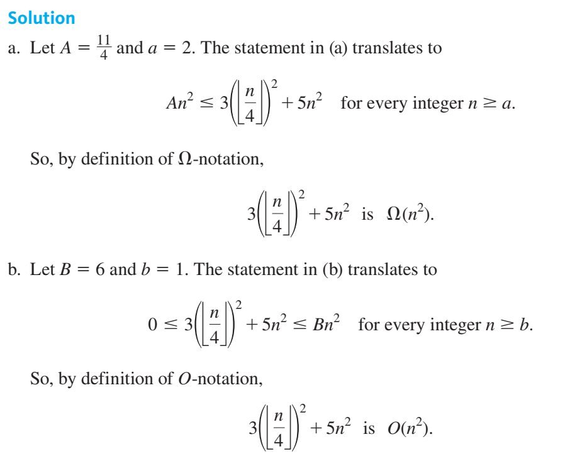

Slide 40
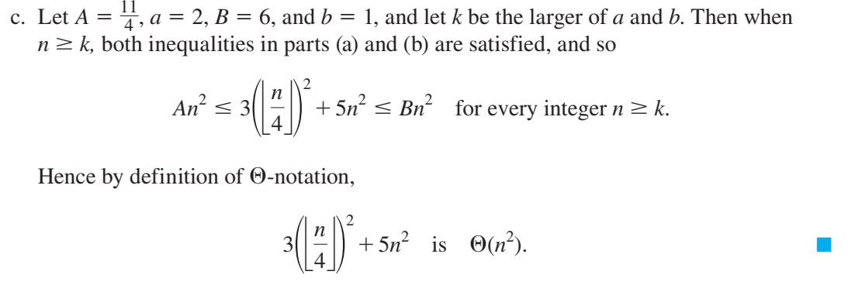

Slide 41
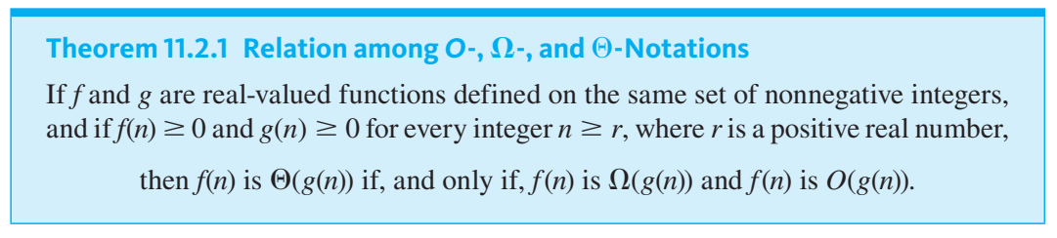

Slide 42
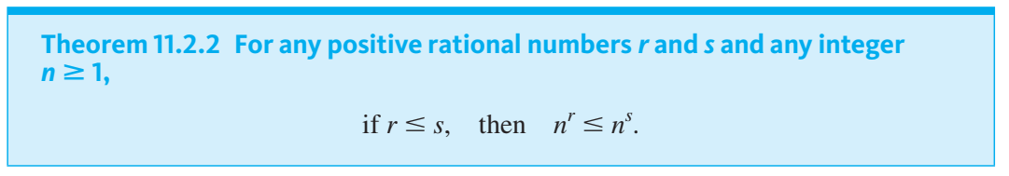
Orders of Power Functions

Slide 43
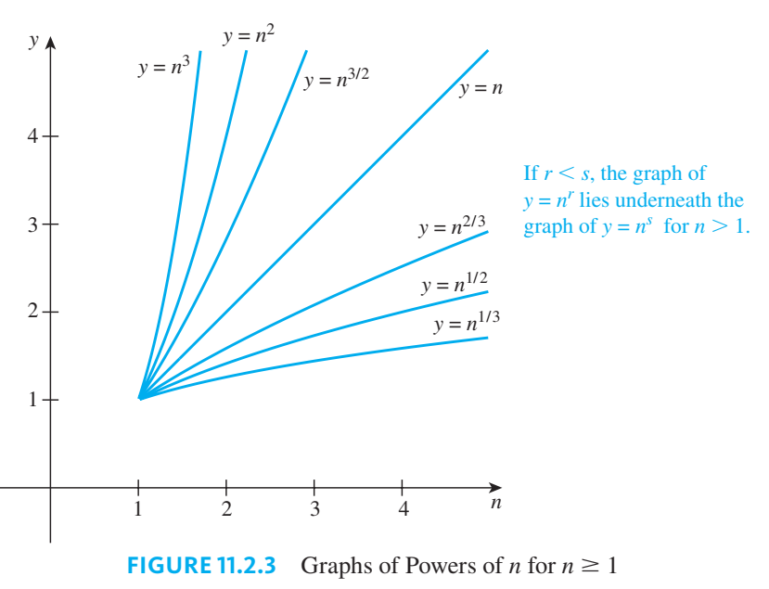

Slide 44
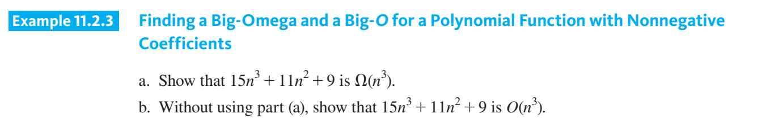

Slide 45
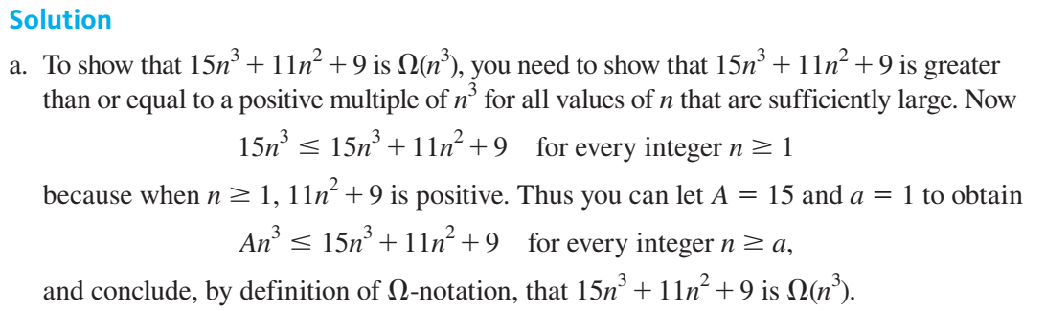

Slide 46
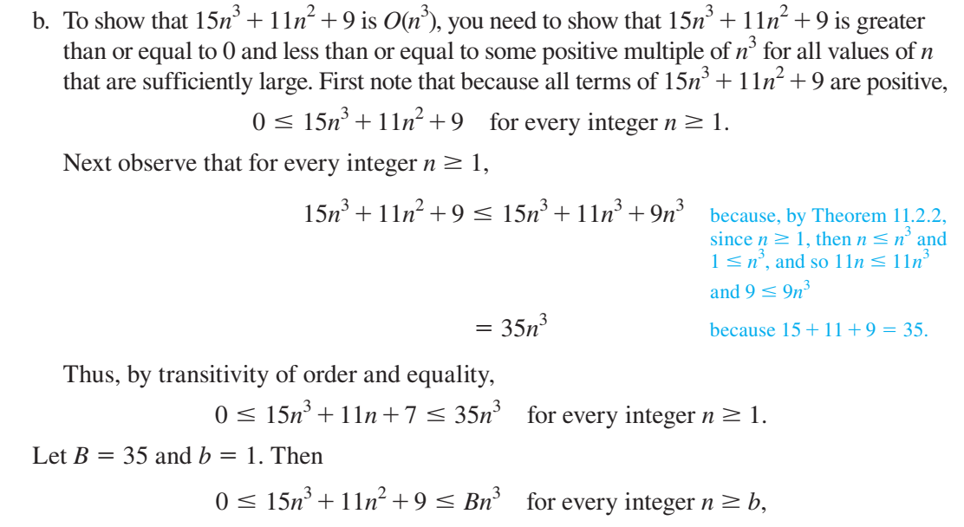

Slide 47
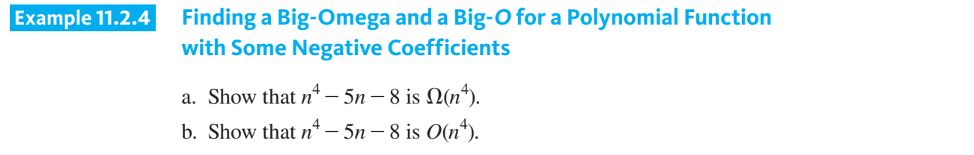

Slide 48
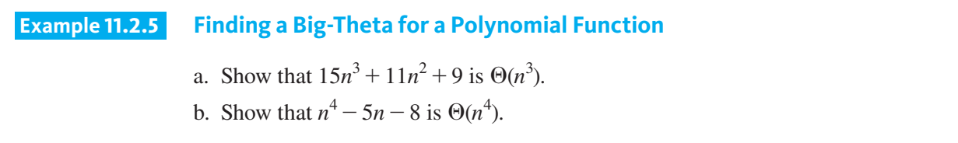

Slide 49
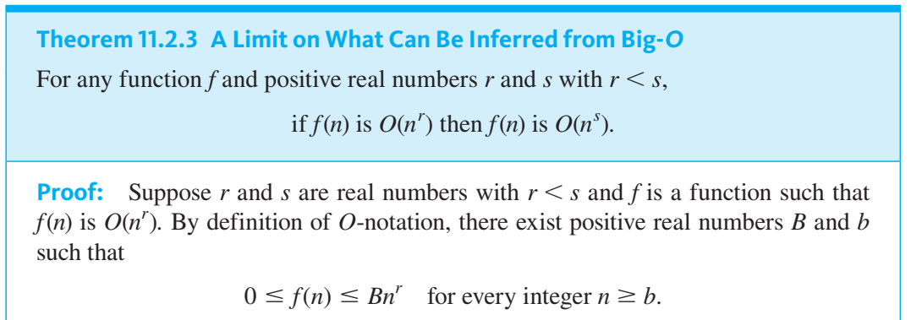
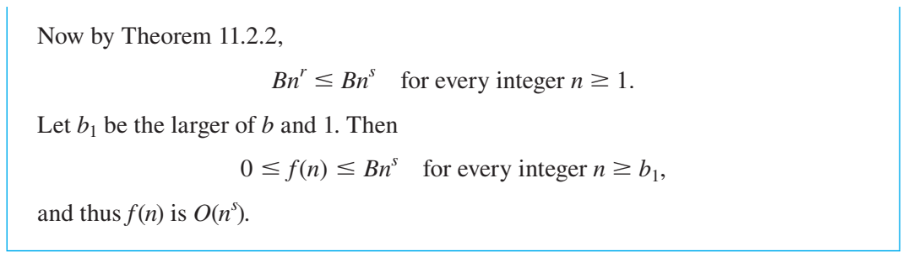

Slide 50
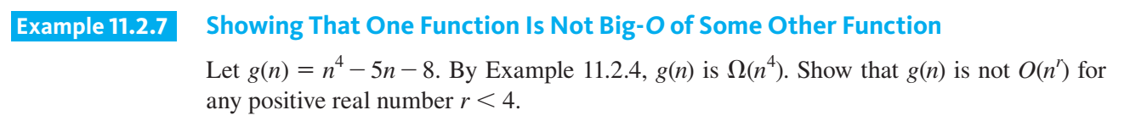

Slide 51
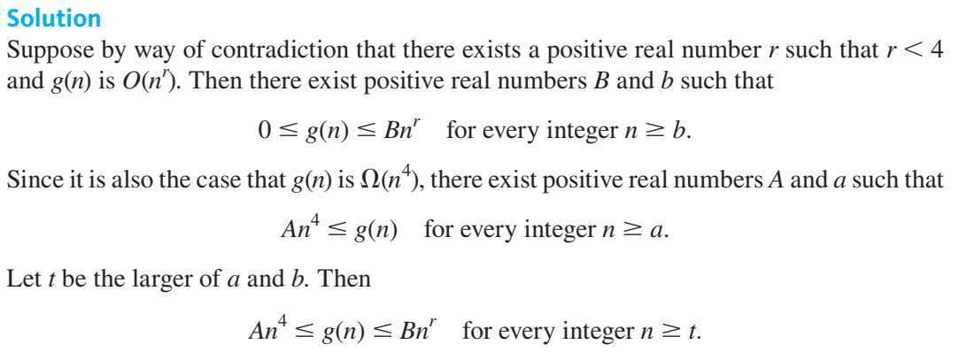

Slide 52
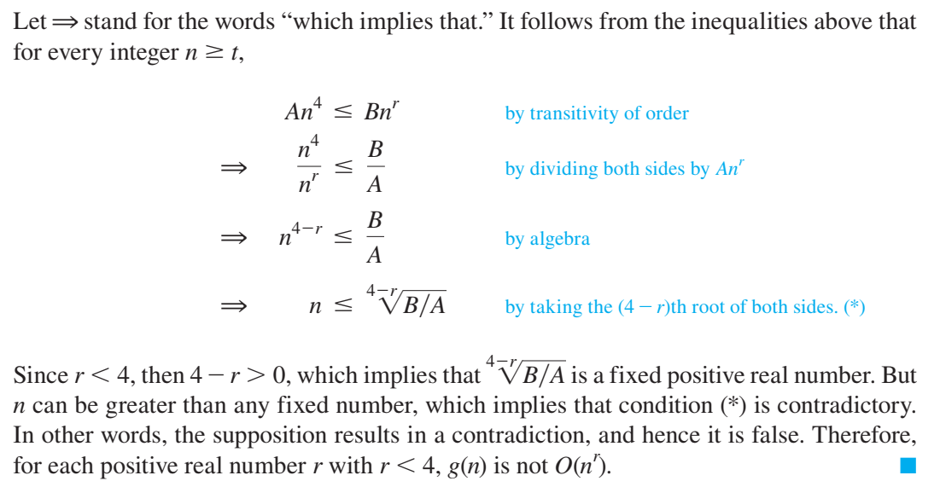

Slide 53
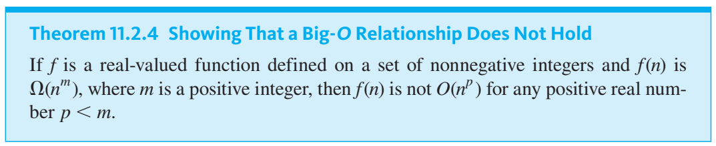

Slide 54
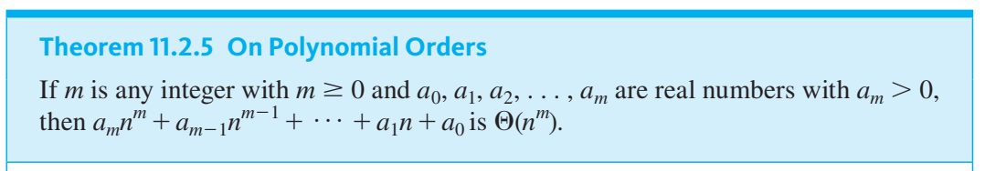

Slide 55
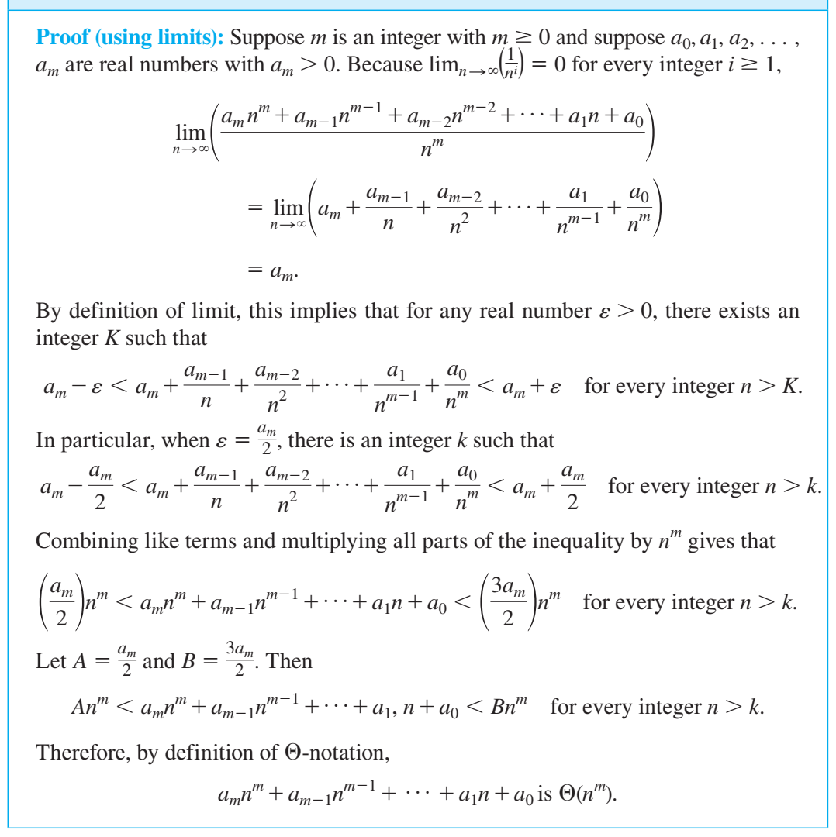

Slide 56


Slide 57


Slide 58


Slide 59


Slide 60


Slide 61


Slide 62


Slide 63


Slide 64


Slide 65



Slide 66


Slide 67


Slide 68


Slide 69


Slide 70


Slide 71



Slide 72


Slide 73


Slide 74


Slide 75


Slide 76



Slide 77


Slide 78


Slide 79
Questions?

